Slide 1

Introduction To Binary Reverse Engineering
Ethical Hacking Club Spring 2021
Jordan Sosnowski
Notes:
https://www.flickr.com/photos/looksgood/20332197581

Slide 2
Outline
What is it, who does it and why?
IA-32 Assembly Crash Course
Binary Reverse Engineering Process
Tools
Labs

Slide 3
What is It, Who uses It, and Why?

Slide 4
What is Binary Reverse Engineering?
Software reverse engineering is the process of taking software apart and analyzing it
Binary reverse engineering is performed if the original source code of the software is not available
Usually, when people refer to reverse engineering regarding cybersecurity, they mean binary reverse engineering
Notes:
https://en.wikipedia.org/wiki/Reverse_engineering

Slide 5
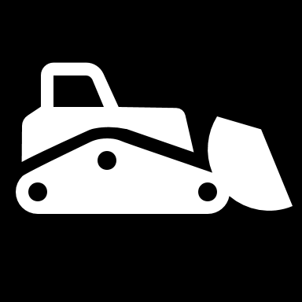
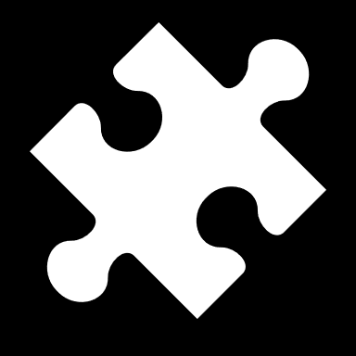
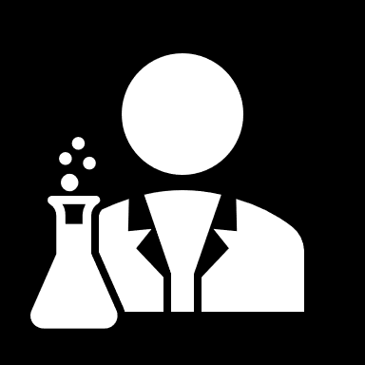
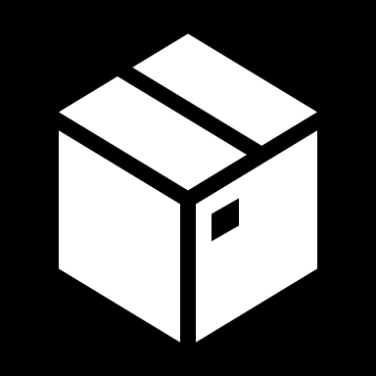
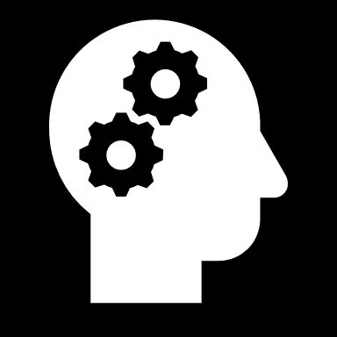
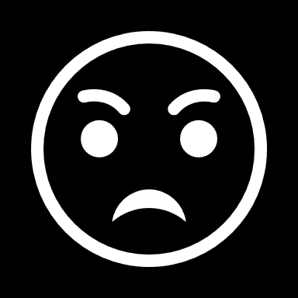
Soft Skills of a Binary Reverse Engineer
Love to take things apart to figure out how it works
Love puzzle solving
Enjoy developing experiments and tools
Can think outside the box
Love constantly learning new things
High tolerance to frustration

Slide 6
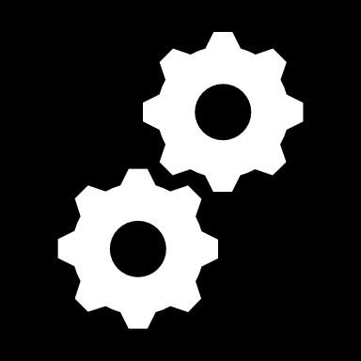
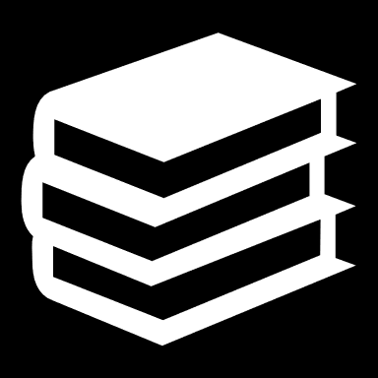
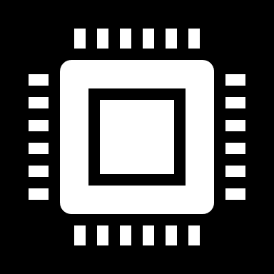
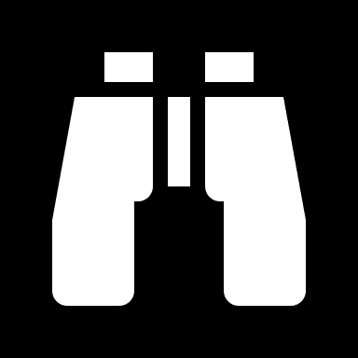
Technical Skills required for Binary Reverse Engineering
Familiarity with an assembly language
Strong knowledge of compiled programming languages
Understanding of bitwise operations and their using in encodings
Ability to Google

Slide 7
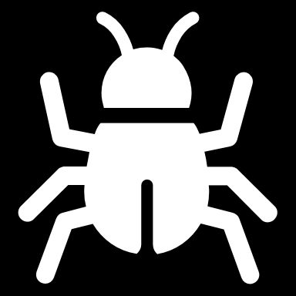
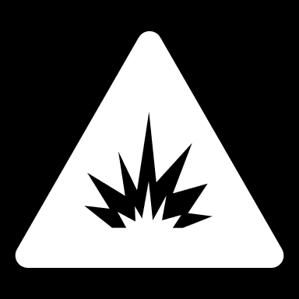
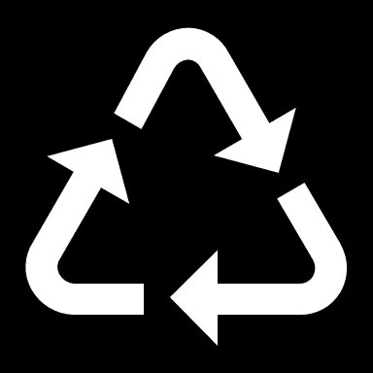
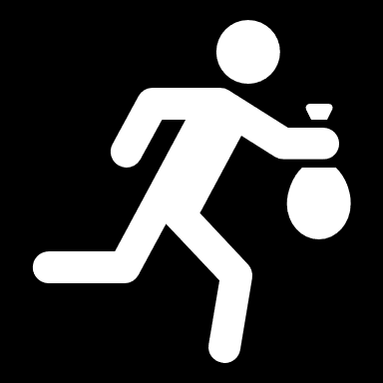
Where Binary Reverse Engineering is used
MALWARE ANALYSIS
BINARY EXPLOITATION
LEGACY CODE SUPPORT
CODE THEFT

Slide 8
Why malware analysis is important
2015
2021
Caused 500 billion dollars of damage
Expected to cause 6 trillion dollars of damage
Caused 2 trillion dollars of damage
2019

Slide 9
Binary Reverse Engineering is Huge
Each operating system has its own binary format
Windows: Portable Executable (PE)
Linux: Executable and Linkable Format (ELF)
macOS: Mach-O
We will be focusing on Windows and the PE format
Notes:
https://en.wikipedia.org/wiki/Comparison_of_executable_file_formats

Slide 10
Background Information

Slide 11
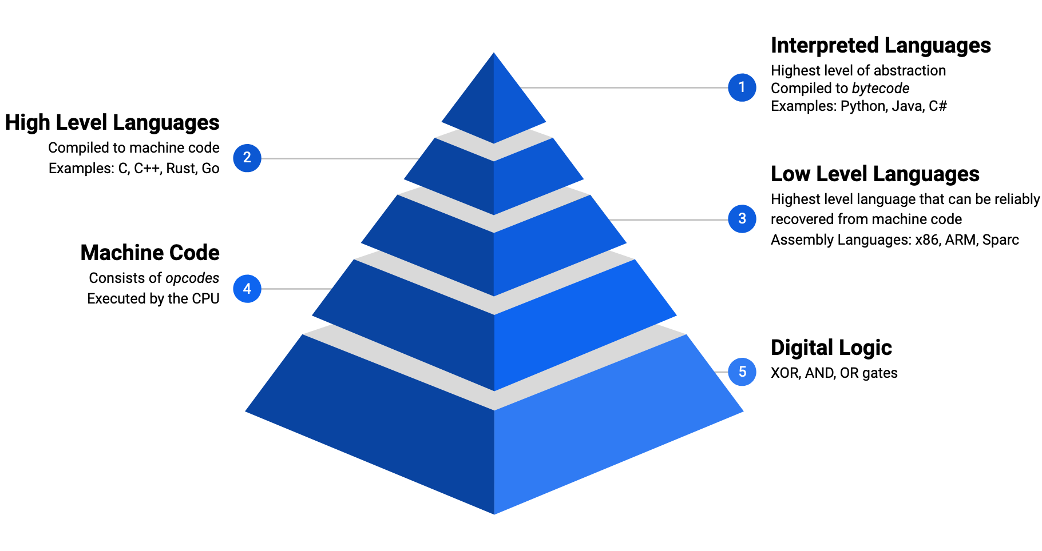
Programing Language Abstraction

Slide 12
What’s a binary file
A computer readable file stored in binary format
Not human readable
Programs are usually generated into binary files
Languages compiled to bytecode can produce binary files which are interpreted by a program and converted to machine instructions for the CPU
Not all binary files are programs (i.e., JPGs and PNGs are binary files)

Slide 13
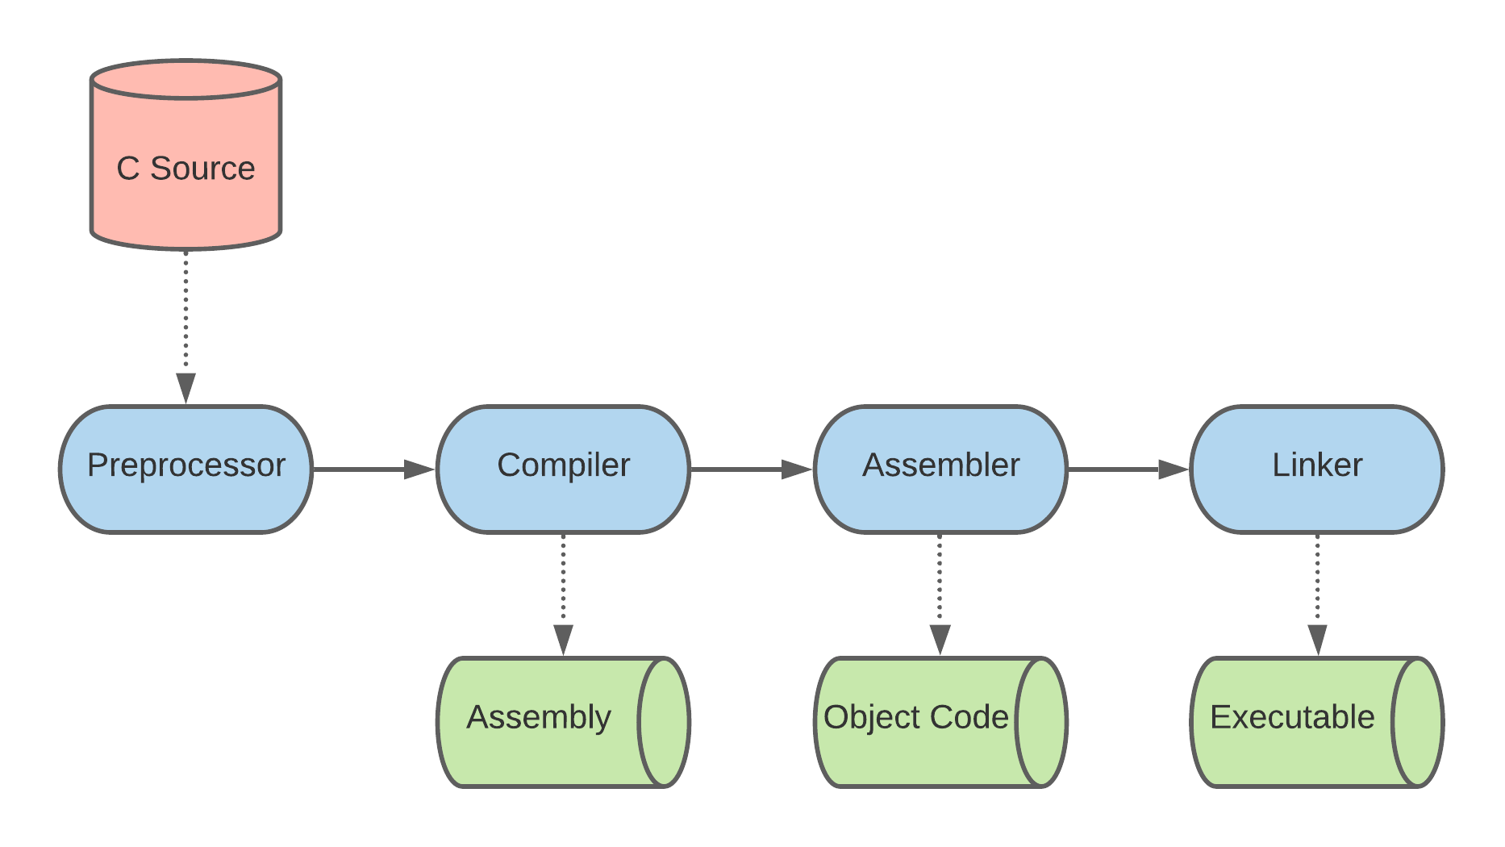
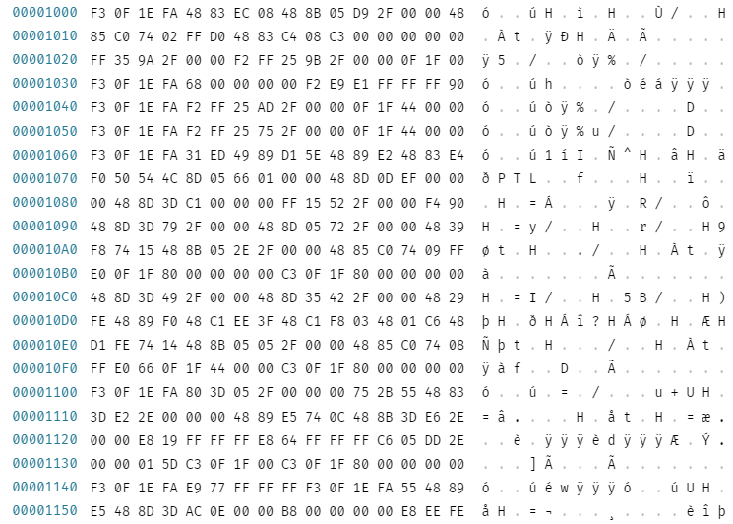
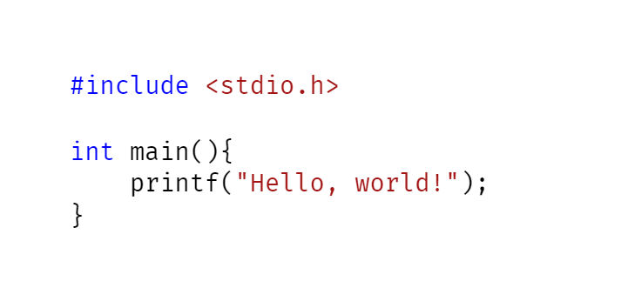
C/C++ Compilation Process
Compiler takes in source code and translates it into something a computer knows how to execute (machine code)
gcc test.c -o test
Compile
Notes:
https://www.geeksforgeeks.org/compiling-a-c-program-behind-the-scenes/

Slide 14
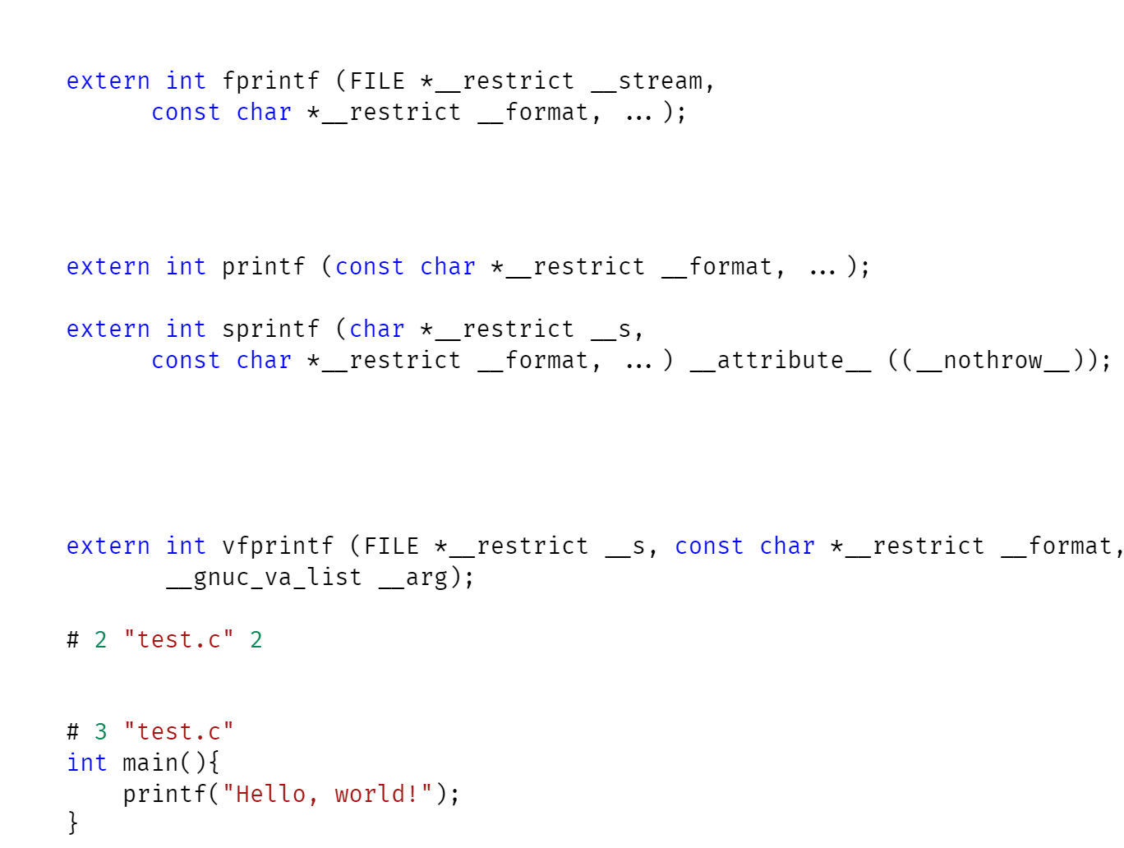
C/C++ Compilation Process – Preprocessor
Expands preprocessor directives (start with #)
Macros
File Inclusion
Conditional Compilation
Other directives
Replaces comments with whitespace
gcc test.c -E
Preprocessor
Notes:
https://www.tutorialspoint.com/cprogramming/c_preprocessors.htm

Slide 15
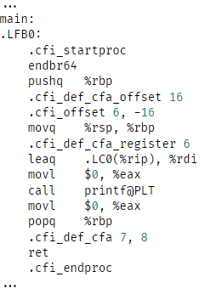
C/C++ Compilation Process – Compiler
Translates the source code into assembly
Additionally, performs optimization on source code
gcc test.c -S
Compile

Slide 16
C/C++ Compilation Process – Assembler
Translates the assembly into machine code.
Adds relevant information for binary format.
External library calls are not yet resolved.
gcc test.c -c
Compile

Slide 17
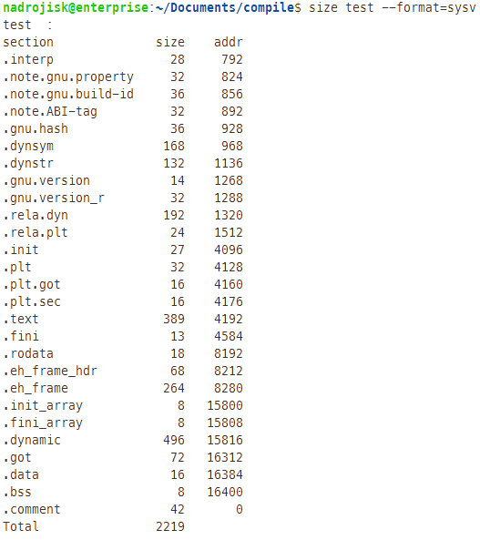
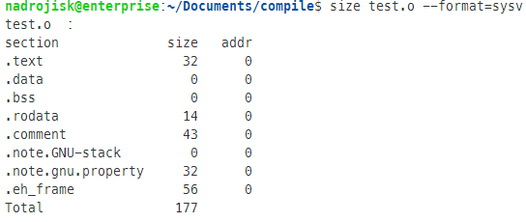
C/C++ Compilation Process – Linker
External library calls are resolved.
Final executable produced
Linker

Slide 18
Linking Types
Static: libraries are copied into the final binary
Larger files
Hard to determine which functions come from libraries
Dynamic: host OS searches for libraries when the program is loaded
Common
Smaller files
Can easily see which functions are imported
Runtime: libraries are pulled when the function is needed
Rare; usually performed by malicious code to obscure functionality
Commonly uses LoadLibrary and GetProcAddress

Slide 19
Number Systems
Decimal, base 10, what humans use
Numbers 0,1,2,3,4,5,6,7,8,9
i = 10^{n}*i_{n}+…+10²*i₂+10¹*i₁+10⁰*i₀
120 = 10²(1)+10*(2)+0
Binary, base 2, what computers use
Numbers 0 and 1
i = 2n*in+…+22*i2+21*i1+20*i0
0b1010 = 2³(1)+2²(0)+2¹(0)+2⁰(1) = 10
Prefixed with 0b
Hexadecimal, base 16, primarily used by computer system designers and programmers, provide a human-friendly representation for binary values
Characters 0,1,2,3,4,5,6,7,8,9,A,B,C,D,E,F
i = 16^{n}*i_{n}+…+16²*i₂+16¹*i₁+16⁰*i₀
0x20 = 16¹(2) + 16⁰(0) = 32
Prefixed with 0x

Slide 20
Binary to Hex
One binary value represents one bit
One hex value represents four binary digits, or four bits
4 bits is also referred to as a nibble
2 bits is a crumb
0b1000 = 0x8
Two hex values represent one byte, or eight bits, aka eight binary digits
0xFF = 0b11111111

Slide 21
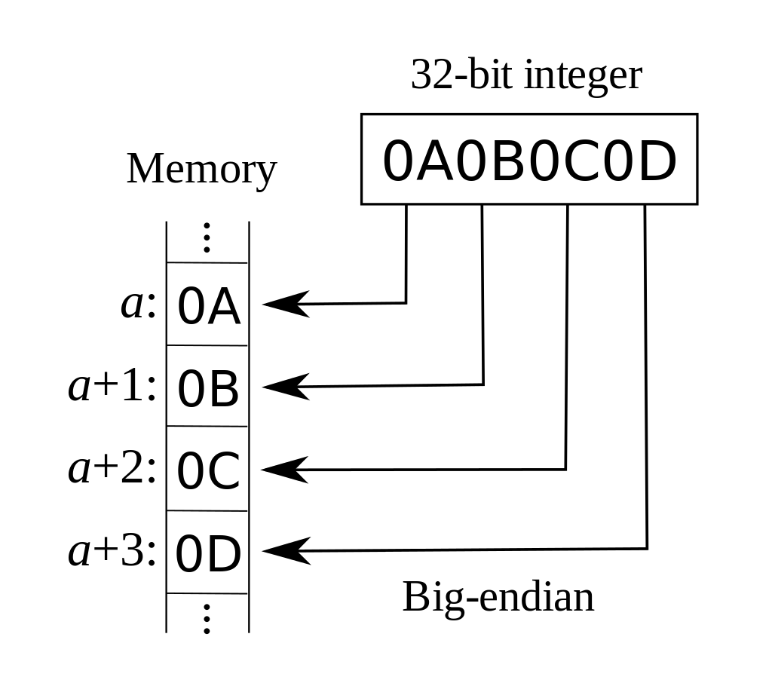
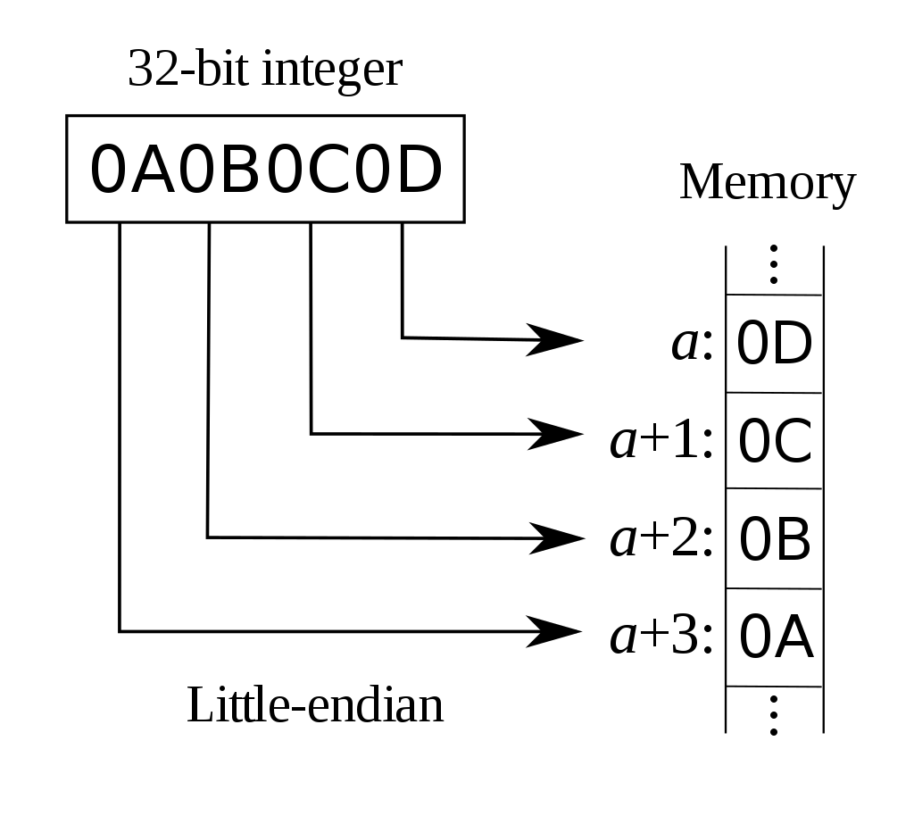
Endianness
Endianness is the order of bytes
Big-endian: most significant byte first
Used by networks (IP, TCP, UDP)
Little-endian: least significant byte first
Used by most operating systems

Slide 22
Data Sizes
Byte: 8 bits
Word: 16 bits or 2 bytes
Double Word (DWORD): 32 bits or 4 bytes
Quadruple Word (QWORD): 64 bits or 8 bytes

Slide 23
Number Systems Quiz Answers
Binary to Hex (1101)₂
0xD
Hex to Decimal 0x0f
(15)₁₀
What is the size of DWORD?
32 bits or 4 bytes

Slide 24
IA-32 Assembly Crash Course
Notes:
http://www.cs.virginia.edu/~evans/cs216/guides/x86.html

Slide 25
Outline
Background
Common Instructions
Logical Operands
Control Flow
Common Data Structures

Slide 26
IA-32 Assembly Crash Course
Background

Slide 27
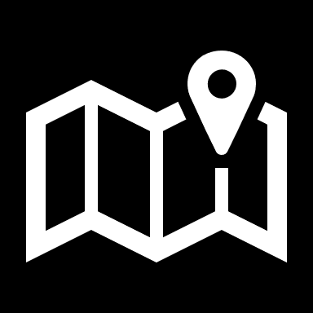
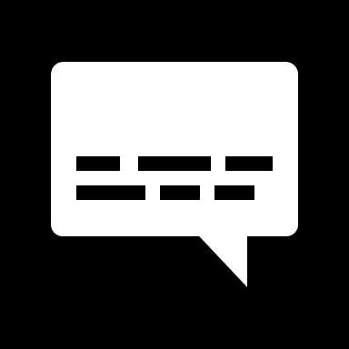
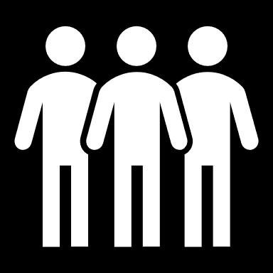
What is Assembly?
A mapping from machine code to the mnemonics
nop → 0x90
Class of Languages

Slide 28
x86 Assembly Language
Family of languages for Intel, and later AMD, processors
Original implementation was for 16-bit machines
IA-32 is the 32-bit version of the language
Sometimes referred to as i386
x86-64 is the 64-bit version of the language
Sometimes referred to as x64
Notes:
https://software.intel.com/content/www/us/en/develop/download/intel-64-and-ia-32-architectures-sdm-combined-volumes-1-2a-2b-2c-2d-3a-3b-3c-3d-and-4.html

Slide 29
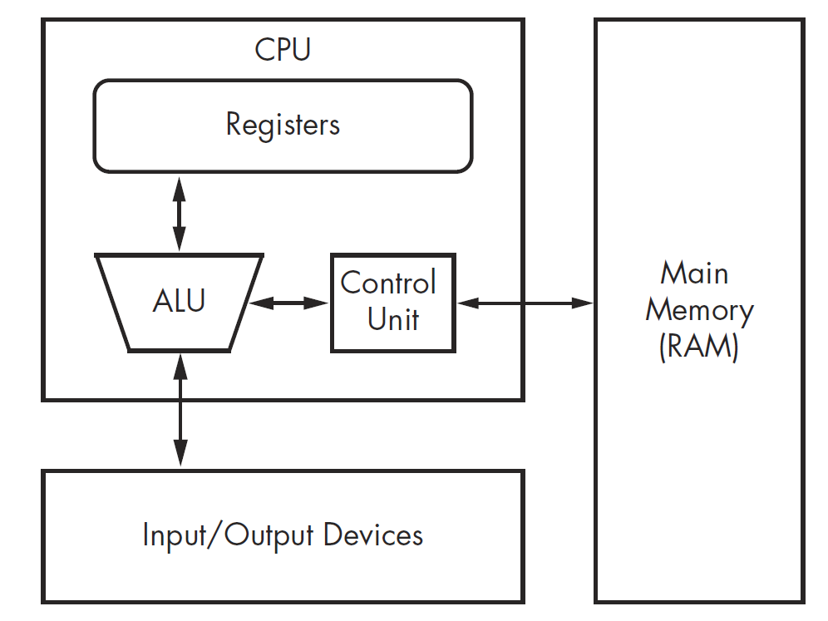
x86 Architecture
The central processing unit (CPU) executes code
The main memory (RAM) stores all the data and code
Input / Output (I/O) devices interface with keyboards, mouse, etc.
Referred to as the Von Neumann Architecture

Slide 30
Hierarchy Storage
Cloud
Hardrive
SIZE INCREASES
RAM
SPEED INCREASES
Cache
Register

Slide 31
Primitive Data Types
Integer:
Whole number
1, 20, 255
4 bytes*
Signed / Unsigned
Float:
Decimal number
1.2, 0.24
8 bytes
Signed / Unsigned
Character:
Single ASCII character
‘A’, ‘a’, ‘1’, ‘-’, ‘%’
1 byte
*Compiler dependent
Notes:
https://docs.microsoft.com/en-us/cpp/cpp/data-type-ranges?view=msvc-160

Slide 32
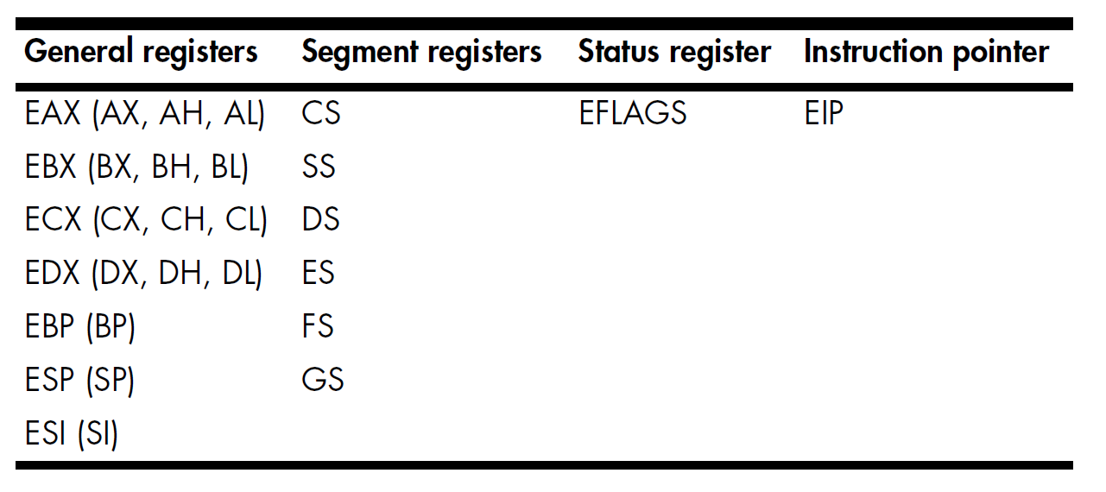
Registers
Small units of storage contained within the CPU
8 General-Purpose Registers
6 Segment Registers
1 Flags Register (EFLAGS)
Instruction Pointer Register (EIP)
Extremely fast
EDI (DI)

Slide 33
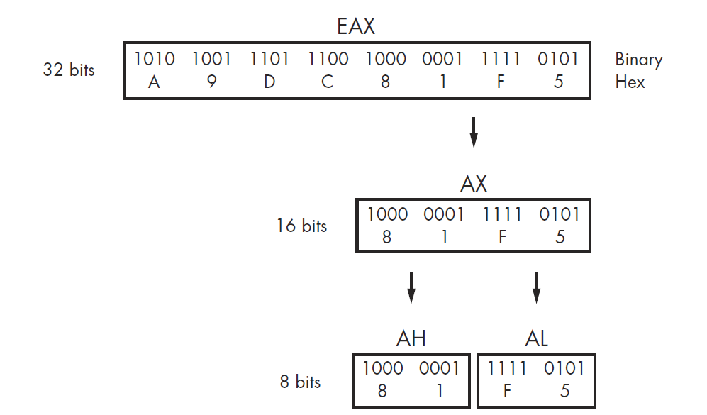
General-Purpose Registers
Each general-purpose register has at most 32-bits when running 32-bit binaries
EAX, EBX, ECX, EDX, EBP, ESP, ESI
All general-purpose registers can be referenced by their 16-bit registers
AX, BX, CX, DX, BP, SP, SI
Some general-purpose registers can be referenced by their 8-bit registers
AL, AH, BL, BH, CL, CH

Slide 34
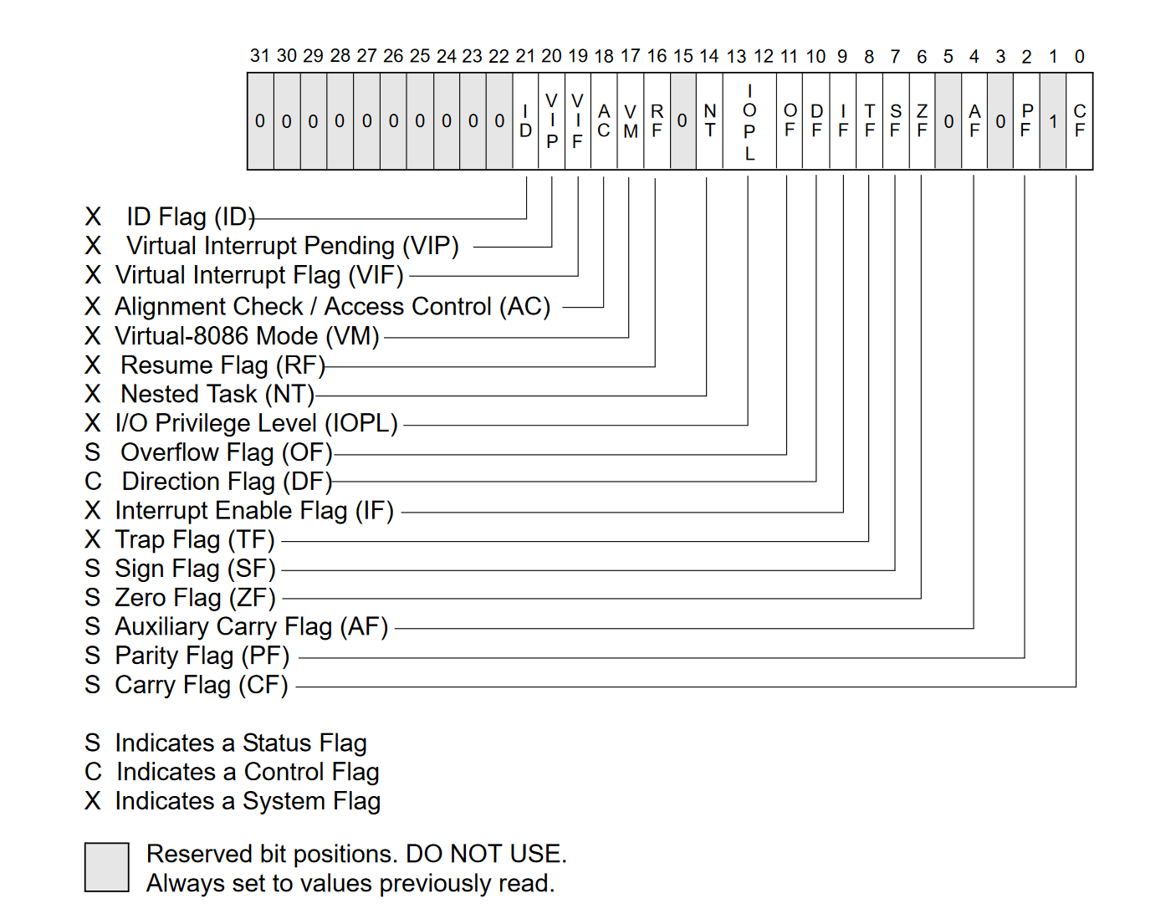
Flags
Flags can determine execution flow and are extremely important
Common Flags
ZF: set when the result of an operation is equal to zero; otherwise, it is cleared
CF: set when the result of an operation is too large or too small for the destination operand; otherwise, it is cleared.
SF: set when the result of an operation is negative or cleared when the result is positive.

Slide 35
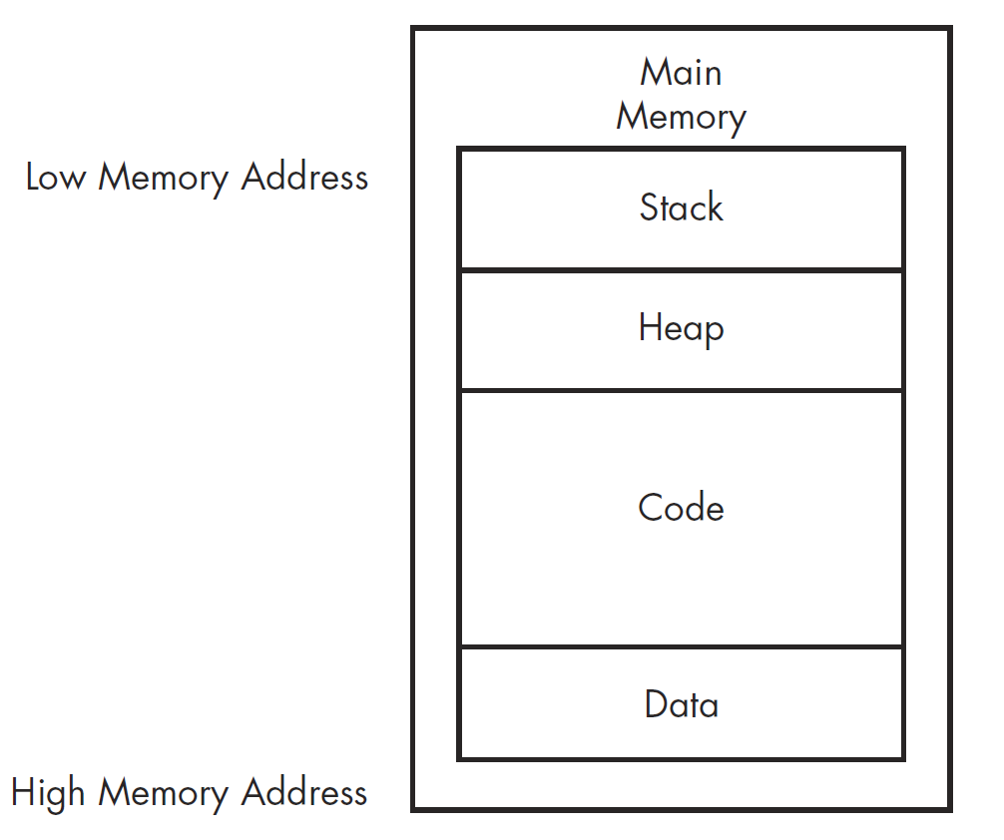
Memory
Memory allocated for a program can be divided into four major sections
Code: consists of all the executable instructions
Sometimes referred to as the text section
Stack: contains local variables and parameters for functions
Heap: contains dynamic memory
Data: contains global and static variables

Slide 36
Calling Conventions
Scheme for how functions handle receiving parameters and how to return their results, if they have any
Varies per architecture and per compiler
Some compilers support multiple calling conventions
Parameters: passed via registers or stack
Stack cleanup: caller function or callee
Return: register

Slide 37
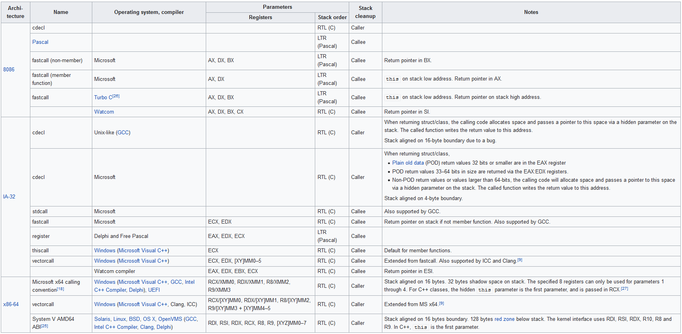

Slide 38
x86 Calling Conventions
cdecl
Usually, the default calling convention
Parameters: passed via stack
Cleanup: caller
Return: EAX
stdcall
Standard calling convention for Microsoft’s Win32 API
Parameters: passed via stack
Cleanup: callee
Return: EAX
fastcall
Parameters: passed via ECX, EDX registers
Cleanup: callee
Return: EAX

Slide 39
Instruction Format
mnemonic op1, op2, op3, …, opN
mnemonic: also referred to as the instruction
Example: and, sub, mov, lea
op#: operands passed to the instruction
The total number depends on the instruction

Slide 40
Intel vs AT&T
Intel
Destination before the source
Size derived from name of register
Assembler detects type of symbols
Used by Windows
Most prefer Intel
AT&T
Destination after the source
Mnemonics denote size
Immediate values prefixed with ‘$’, registers ‘%’
Used by Linux, Unix, and macOS

Slide 41
Intel vs AT&T Example
Intel
mov EAX, 5
add ESP, 4
AT&T
mov $5, %EAX
addl $4, %ESP

Slide 42
Registers/Flags Quiz
How many bits in EAX?
32 bits
How many bits in AX?
16 bits
When is the ZF flag set?
When the result of an operation is equal to zero

Slide 43
IA-32 Assembly Crash Course
Common Instructions

Slide 44
MOV
mov destination, source
Move data from source into destination
Example
EAX = 20
EBX = 40
mov EBX, EAX
EBX will contain 20

Slide 45
MOV – Pointers
mov can be used to dereference pointers
Uses the [ ] syntax
Can be used on the source or destination operand
Example
EAX = 0xff40 ;Address 0xff40 contains 0x20
mov EBX,[EAX]
EBX will now contain 0x20

Slide 46
MOV – Pointer Example
Assume EAX = 0, EBX = 0, ESP = 0x4040
mov EAX, ESP
mov BYTE PTR [EAX], 20
mov EBX, [ESP]
; EAX = 0x4040
; 0x4040 -> 20
; EBX = 20

Slide 47
LEA
lea destination, [source]
Load effective address from source into destination
Unlike mov, the brackets must be used and can only be used on source
Grabs the address of the source variable
i.e., &some_variable
Example
mov EAX, 0xff40
mov BYTE PTR [EAX], 20
lea EBX, [EAX]
EBX contains 0xff40

Slide 48
LEA – Arithmetic
Can also be used for quick arithmetic
Example
LEA EAX, [20+2*4]
EAX will contain 28

Slide 49
ADD
add destination, source
add will add the source to the destination and stores it into destination
Example
MOV EAX, 10
MOV EBX, 5
ADD EAX, EBX
EAX now contains 15

Slide 50
SUB
sub destination, source
sub will subtract source from destination and store the result into destination

Slide 51
INC / DEC
inc register
Increment register by one and store into register
dec register
Decrement register by one and store into register

Slide 52
SHL / SAL
shl source, value
Bit shift source to the left by value
shl: Shift logical left
sal: Shift arithmetic left
Example
mov eax, 4
shl eax, 2
EAX contains 16
Formula: source * 2^{value}

Slide 53
SHR / SAR
shr source, value
Bit shift source to the right by value
shr: Shift logical right
sar: Shift arithmetic right
Example
mov eax, 4
shr eax, 1
EAX contains 2
Formula: source / 2^{value}

Slide 54
MUL / IMUL
mul value
Multiplies value by EAX and stores into EDX and EAX
imul value
Multiplies value by EAX and stores into EDX and EAX, keeps sign
imul destination, source
Multiples destination by source and stores into destination

Slide 55
DIV / IDIV
div value
Divides value by EDX:EAX and stores remainder into EDX and value into EAX
idiv value
Divides value by EDX:EAX and stores remainder into EDX and value into EAX, keeps sign

Slide 56
Size Directives
The size of a data item can usually be inferenced
mov EAX, EBX
Move the 4-byte value stored in EBX into EAX
You can infer 4 bytes as EBX is 4-bytes long
Sometimes it is ambiguous
mov[EAX], 8
Should 8 be one byte (0b1000), two bytes (0b00001000), three, four?
Directives are used to explicitly specify the size
BYTE PTR – 1 Byte
WORD PTR – 2 Bytes
DWORD PTR – 4 Bytes

Slide 57
Size Directive – Example
mov BYTE PTR [eax], 8
move byte representation of 8 into the single byte at the address stored in EAX
mov WORD PTR [eax], 8
move the 2-byte representation of 8 into the 2 bytes at the address in EAX
mov DWORD PTR [eax], 8
move the 4-byte representation of 8 into the 4 bytes at the address in EAX

Slide 58
Common Instructions Quiz
Assume EBX = 25
What is in EAX after each of the following instructions?
MOV EAX, EBX
ADD EAX, EBX
INC EAX

Slide 59
Common Instructions Quiz Answers
Assume EBX = 25
What is in EAX after each of the following instructions?
MOV EAX, EBX → EAX = 25
ADD EAX, EBX → EAX = 25 + 25 = 50
INC EAX → EAX = 50 + 1 = 51

Slide 60
IA-32 Assembly Crash Course
Logical Operands

Slide 61
Basic Logic Operations
and
Intersection between two values
0b1001 and 0b1010 → 0b1000
1 and 1 → 1
1 and 0 → 0
0 and 1 → 0
0 and 0 → 0
xor
Exclusive intersection between two values
0b1001 xor 0b1010 → 0b0011
1 xor 1 → 0
1 xor 0 → 1
0 xor1 → 1
0 xor 0 → 0
or
Union between two values
0b1001 or 0b1010 → 0b1011
Truth Table
1 or 1 → 1
1 or 0 → 1
0 or 1 → 1
0 or 0 → 0
not
Negation of value
not 0b1001 → 0b0110
Truth Table
not 1 → 0
not 0 → 1

Slide 62
AND
and destination, source
Performs a bitwise and on destination and source and stores result in destination
Example
mov EAX, 4 (0b0101)
mov EBX, 8 (0b1001)
and EAX, EBX
EAX contains 1

Slide 63
OR
or destination, source
Performs a bitwise or on destination and source and stores result in destination
Example
mov EAX, 5 (0b0101)
mov EBX, 9 (0b1001)
or EAX, EBX
EAX contains 13 (0b1101)

Slide 64
XOR
xor destination, source
Performs a bitwise xor on destination and source and stores result in destination
Example
mov EAX, 5 (0b0101)
mov EBX, 9 (0b1001)
xor EAX, EBX
EAX contains 12 (0b1100)

Slide 65
NOT
not destination
Performs a bitwise negation on destination and stores in destination
Example
mov EAX, 6 (0b0110)
not AL
EAX contains 9 (0b1001)

Slide 66
NEG
neg destination
Replaces value of destination with two’s complement
Example
mov EAX, 6 (0b0110)
neg EAX
EAX contains -6 (0b1010)

Slide 67
Two’s Complement
Method of signed number representation
Method
Swap bits
Add 1
Example -7 → 0b0111
0b0111 ; 7 in binary
0b1000 ; swap bits
0b1001 ; add 1

Slide 68
Logical Quiz
Assume EAX = 0b0101 and EBX = 0b0010
and EAX, EBX
Assume EAX = 0b0111 and EBX = 0b0100
or EAX, EBX
What is the two’s complement of 0b0110?

Slide 69
Logical Quiz
Assume EAX = 0b0101 and EBX = 0b0010
and EAX, EBX → EAX = 0b0101 & 0b0010 = 0b0000
Assume EAX = 0b0111 and EBX = 0b0100
or EAX, EBX → EAX = 0b0101 | 0b0100 = 0b0101
What is the two’s complement of 0b0110?
0b1010

Slide 70
IA-32 Assembly Crash Course
Control Flow

Slide 71
Labels
<label> is used to refer to a labeled location in the program code
Can be added anywhere by using the following format
<label>:
Example:
main:
mov eax, 0
add eax, 10

Slide 72
Flags
Flags can determine execution flow and are extremely important
Common Flags
ZF: set to one when the result of an operation is equal to zero; otherwise, it is cleared to zero.
CF: set when the result of an operation is too large or too small for the destination operand; otherwise, it is cleared.
SF: set when the result of an operation is negative or cleared when the result is positive.

Slide 73
CMP
cmp destination, source | ZF | CF
destination = source | 1 | 0
destination > source | 0 | 0
destination < source | 0 | 1
cmp destination, source
Compares destination against source
Subtracts source from destination
Does not store result

Slide 74
TEST
test destination, source
Tests destination against source
and’s source against destination
Does not store result, purely sets flags
Usually used against itself to see if a value is zero
Example
test eax, eax
If EAX contains anything other than zero, then the ZF is set to 0
Else it is set to 1

Slide 75
JMP
jmp address
Unconditional jump to address
Labels can be jumped to
add:
add eax, 20
jmp l1
main:
mov eax, 0
jmp add
l1:
exit

Slide 76
Conditional Jumps
JZ: Jump if zero
If prior command sets the zero-flag jump
JNZ: Jump if not zero
If prior command does not set the zero-flag jump
JL: Jump if less
If prior comparison is less, jump
JG: Jump if greater
If prior comparison is greater, jump

Slide 77
Conditional Jump – Examples
EAX = 20
EBX = 10
cmp EAX, EBX
jz foo
Don’t Jump
cmp EAX, EBX
jg foo
Take Jump
cmp EAX, EBX
jl foo
Don’t Jump

Slide 78
CALL / RET
call address/<label>
Change's execution flow to the address specified
Behind the scene:
EIP is pushed to the stack
EIP is set to address
ret
Return from function and resume execution from before function call

Slide 79
Program Flow Quiz
Assume EAX = 30 and EBX = 15
cmp EAX, EBX
Take jump or don’t jump?
jz foo
jnz foo
jl foo
jg foo

Slide 80
Program Flow Quiz Answers
Assume EAX = 30 and EBX = 15
cmp EAX, EBX
Take jump or don’t jump?
jz foo - Don’t Jump
jnz foo - Take Jump
jl foo - Don’t Jump
jg foo - Take Jump

Slide 81
IA-32 Assembly Crash Course
Stack and Heap

Slide 82
Memory
Memory allocated for a program can be divided into four major sections
Code: consists of all the executable instructions
Sometimes referred to as the text section
Stack: contains local variables and parameters for functions
Heap: contains dynamic memory
Data: contains global and static variables

Slide 83
Stack
High address
EBP + 16 | C
EBP + 12 | B
EBP + 8 | A
EBP + 4 | return address
EBP | saved ebp | ←EBP
EBP – 4 | xx
EBP – 8 | yy
EBP – 12 | zz
EBP – 16 | sum | ←ESP
Low Address
Registers:
EBP: Base of the stack
ESP: Head of the stack
Last in First Out data structure
The stack has a HEAD DOWN orientation
The stack grows DOWN to LOWER memory
Two Commands
push EAX
Subtract ESP by a dword and store EAX
pop EAX
Store contents of ESP in EAX and add ESP by a dword

Slide 84
Stack Example
push 10
EBP
0x29
0x31
0x44
push 40
ESP
pop EBX
0x0A
EBX
0x28
0x28

Slide 85
Stack Prologue
For entering and leaving functions the compiler usually inserts code to create and destroy the stack frame
Note: this is not required, and compilers can skip this step
Epilogue
push ebp
mov ebp, esp
sub esp, N
Can also be achieved with the enter N, 0 instruction
Not common
Notes:
https://en.wikipedia.org/wiki/Function_prologue

Slide 86
Stack Epilogue
For entering and leaving functions the compiler usually inserts code to create and destroy the stack frame
Note: this is not required, and compilers can skip this step
Epilogue
mov esp, ebp
pop ebp
ret
The first two lines can be achieved with the leave instruction

Slide 87
Stack Prologue / Epilogue – Example
int main(){
int i = 10;
int j = 20;
int k = 30;
int l;
l = mul(i, j, k);
return l;
}
main:
push ebp
mov ebp, esp
sub esp, 16
mov DWORD PTR [ebp-4], 10
mov DWORD PTR [ebp-8], 20
mov DWORD PTR [ebp-12], 30
sub esp, 4
push DWORD PTR [ebp-12]
push DWORD PTR [ebp-8]
push DWORD PTR [ebp-4]
call mul
add esp, 16
mov DWORD PTR [ebp-16], eax
mov eax, DWORD PTR [ebp-16]
leave
ret
prologue
epilogue

Slide 88
Stack Frame
High address
int add(int x, int y)
{
int c = x + y;
return c;
}
int main(int argc, const *argv[])
{
int i = add(2, 4);
return 0;
}
EBP + 12 | 4
EBP + 8 | 2
EBP + 4 | return address
EBP | saved ebp | ←EBP
EBP – 4 | c | ←ESP
Low Address

Slide 89
Stack Example – Main
int main(){
int i = 10;
int j = 20;
int k = 30;
int l;
l = mul(i, j, k);
return l;
}
int mul(int x, int y, int z){
int a = x * y;
int b = a * z;
int c = b;
return c;
}
main:
push ebp
mov ebp, esp
sub esp, 16
mov DWORD PTR [ebp-4], 10
mov DWORD PTR [ebp-8], 20
mov DWORD PTR [ebp-12], 30
sub esp, 4
push DWORD PTR [ebp-12]
push DWORD PTR [ebp-8]
push DWORD PTR [ebp-4]
call mul
add esp, 16
mov DWORD PTR [ebp-16], eax
mov eax, DWORD PTR [ebp-16]
leave
ret
High address
←ESP
EBP →
saved ebp
10
EBP - 4
EBP - 8
EBP - 12
EBP - 16
20
30
EBP - 20
EBP - 24 | 30
EBP - 28 | 20
EBP - 32 | 10
EBP - 36 | ret

Slide 90
Stack Example – Mul
int main(){
int i = 10;
int j = 20;
int k = 30;
int l;
l = mul(i, j, k);
return l;
}
int mul(int x, int y, int z){
int a = x * y;
int b = a * z;
int c = b;
return c;
}
mul:
push ebp
mov ebp, esp
sub esp, 16
mov eax, DWORD PTR [ebp+8]
imul eax, DWORD PTR [ebp+12]
mov DWORD PTR [ebp-4], eax
mov eax, DWORD PTR [ebp-8]
imul eax, DWORD PTR [ebp+16]
mov DWORD PTR [ebp-8], eax
mov eax, DWORD PTR [ebp-8]
mov DWORD PTR [ebp-12], eax
mov eax, DWORD PTR [ebp-12]
leave
ret
High address
EBP →
saved ebp
10
EBP - 4
EBP - 8
EBP - 12
EBP - 16
20
30
EBP - 20
EBP - 24 | 30
EBP - 28 | 20
EBP - 32 | 10
EBP - 36 | ret
←ESP
EBP - 40 | main ebp

Slide 91
Stack Example – Mul
int main(){
int i = 10;
int j = 20;
int k = 30;
int l;
l = mul(i, j, k);
return l;
}
int mul(int x, int y, int z){
int a = x * y;
int b = a * z;
int c = b;
return c;
}
mul:
push ebp
mov ebp, esp
sub esp, 16
mov eax, DWORD PTR [ebp+8]
imul eax, DWORD PTR [ebp+12]
mov DWORD PTR [ebp-4], eax
mov eax, DWORD PTR [ebp-4]
imul eax, DWORD PTR [ebp+16]
mov DWORD PTR [ebp-8], eax
mov eax, DWORD PTR [ebp-8]
mov DWORD PTR [ebp-12], eax
mov eax, DWORD PTR [ebp-12]
leave
ret
High address
 | …
EBP + 16 | 30
EBP + 12 | 20
EBP + 8 | 10
EBP + 4 | ret
 | main ebp
EBP →
←ESP
200
EBP - 4
EBP - 8
EBP - 12
EBP - 16
6000
6000
EAX →
6000
200
10

Slide 92
Stack Example – Main
int main(){
int i = 10;
int j = 20;
int k = 30;
int l;
l = mul(i, j, k);
return l;
}
int mul(int x, int y, int z){
int a = x * y;
int b = a * z;
int c = b;
return c;
}
main:
push ebp
mov ebp, esp
sub esp, 16
mov DWORD PTR [ebp-4], 10
mov DWORD PTR [ebp-8], 20
mov DWORD PTR [ebp-12], 30
sub esp, 4
push DWORD PTR [ebp-12]
push DWORD PTR [ebp-8]
push DWORD PTR [ebp-4]
call mul
add esp, 16
mov DWORD PTR [ebp-16], eax
mov eax, DWORD PTR [ebp-16]
leave
ret
High address
EBP →
saved ebp
10
EBP - 4
EBP - 8
EBP - 12
EBP - 16
20
30
6000
EBP - 20
EBP - 24 | 30
EBP - 28 | 20
EBP - 32 | 10
←ESP
EAX →
6000

Slide 93
Stack Frame – Quiz
High address
int add(int x, int y, int z)
{
int c = x + y;
int d = c + z;
return d;
}
int main(int argc, const *argv[])
{
int i = add(2, 4, 24);
return 0;
}
EBP + 0x10 | 0x18
EBP + 0xC | 0x4
EBP + 0x8 | 0x2
EBP + 0x4 | return address
EBP | saved ebp | ←EBP
EBP – 0x4 | c
EBP – 0x8 | d | ←ESP
Low Address

Slide 94
The Heap
Is extremely complicated
All we care about is that it is used for dynamic memory
It is used:
C
calloc, malloc, free
C++ / Java
new operator
new Box();

Slide 95
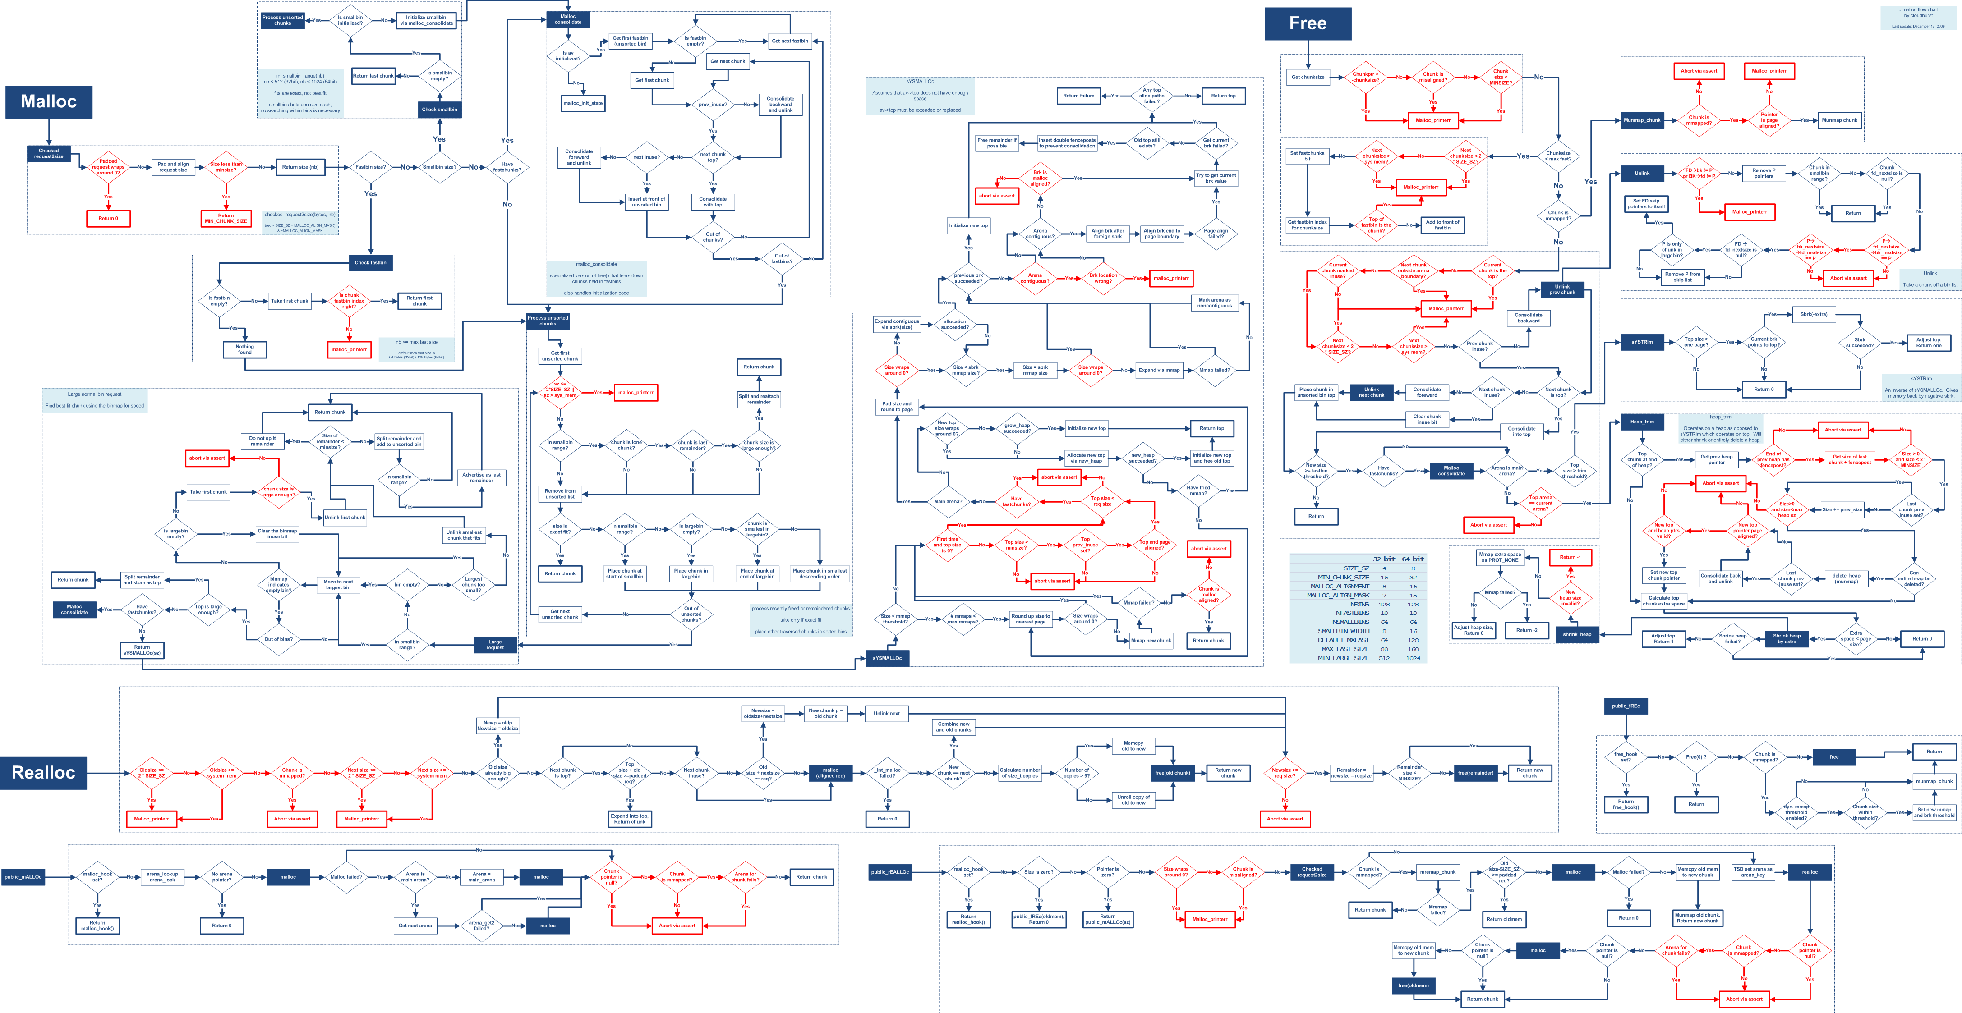

Slide 96
IA-32 Assembly Crash Course
Common Data Structures

Slide 97
Conditions
int main()
{
int i = 10;
if (i < 10)
{
return 20;
}
return 10;
}
main:
push ebp
mov ebp, esp
sub esp, 16
mov DWORD PTR [ebp-4], 10
cmp DWORD PTR [ebp-4], 9
jg .L2
mov eax, 20
jmp .L3
.L2:
mov eax, 10
.L3:
leave
ret

Slide 98
Loops
int main()
{
int i = 0;
for (; i < 10;)
{
i++;
}
return 0;
}
main:
push ebp
mov ebp, esp
sub esp, 16
mov DWORD PTR [ebp-4], 0
.L3:
cmp DWORD PTR [ebp-4], 9
jg .L2
add DWORD PTR [ebp-4], 1
jmp .L3
.L2:
mov eax, 0
leave
ret

Slide 99
Arrays – Integer
int main()
{
int i[5] = {0,
1,
2,
3,
4};
int j[10];
for (int k = 0; k < 10; k++)
{
j[k] = k;
}
return 0;
}
main:
push ebp
mov ebp, esp
sub esp, 64
mov DWORD PTR [ebp-24], 0
mov DWORD PTR [ebp-20], 1
mov DWORD PTR [ebp-16], 2
mov DWORD PTR [ebp-12], 3
mov DWORD PTR [ebp-8], 4
mov DWORD PTR [ebp-4], 0
.L3:
cmp DWORD PTR [ebp-4], 9
jg .L2
mov eax, DWORD PTR [ebp-4]
mov edx, DWORD PTR [ebp-4]
mov DWORD PTR [ebp-64+eax*4], edx
add DWORD PTR [ebp-4], 1
jmp .L3
.L2:
mov eax, 0
leave
ret

Slide 100
Functions
int add(int x, int y)
{
return x + y;
}
int main()
{
int i = add(2, 3);
return i;
}
add(int, int):
push ebp
mov ebp, esp
mov edx, DWORD PTR [ebp+8]
mov eax, DWORD PTR [ebp+12]
add eax, edx
pop ebp
ret
main:
push ebp
mov ebp, esp
sub esp, 16
push 3
push 2
call add
add esp, 8
mov DWORD PTR [ebp-4], eax
mov eax, DWORD PTR [ebp-4]
leave
ret

Slide 101
Program Example
#include <stdlib.h>
int main(){
int *arr = malloc(sizeof(arr) * 10);
for (int i = 0; i < 10; i++){
arr[i] = i+20;
}
}
main:
lea ecx, [esp+4]
and esp, -16
push DWORD PTR [ecx-4]
push ebp
mov ebp, esp
push ecx
sub esp, 20
sub esp, 12
push 40
call malloc
add esp, 16
mov DWORD PTR [ebp-16], eax
mov DWORD PTR [ebp-12], 0
jmp .L2
.L3:
mov eax, DWORD PTR [ebp-12]
lea edx, [0+eax*4]
mov eax, DWORD PTR [ebp-16]
add eax, edx
mov edx, DWORD PTR [ebp-12]
add edx, 20
mov DWORD PTR [eax], edx
add DWORD PTR [ebp-12], 1
.L2:
cmp DWORD PTR [ebp-12], 9
jle .L3
mov eax, 0
mov ecx, DWORD PTR [ebp-4]
leave
lea esp, [ecx-4]
ret

Slide 102
Lab
Generate C program (5 – 10 lines max) that uses basic data structures discussed earlier
Go to https://godbolt.org/
Ensure Default Language is C and –m32 is the compiler flag
Practice understanding how the assembly is generated

Slide 103
Next Week
Static Analysis Deep Dive
PE File
Packed Binaries
How to use Ghidra

Slide 104
References
Reverse Engineering for Beginners
https://beginners.re/
Reversing: Secrets of Reverse Engineering
Practical Malware Analysis: The Hands-On Guide to Dissecting Malicious Software
Assembly Language for x86 Processors

